Slide 1
The Indian desert
To the north of Aravali hills lies – Great Indian Desert
This receives low rainfall below 150 mm per year
It has arid climate with low vegetatin cover
Due to this is also known as Marusthali
During the Mesozoic era this was under the sea
Believed by the eveidence available at wood fossils park at Aakal and marine deposits near Jaisalmar (estimated to be 180 million years)

Slide 2
Some of the features:
Rock structure of the of the desert is an extension of the Peninsular plateau
Due to extreme arid conditions, its surface features have been carved by physical weathering and wind actions
Well pronounced desert land features present here are mushroom rocks, shifting dunes and oasis.

Slide 3
The desert divided into two parts
The northern part is sloping towards Sindh and the Southern towards the Rann of Kachchh
The Southern part extended up to Banas
The lakes and plays have brackish water which is the main source of obtaining salt.

Slide 4
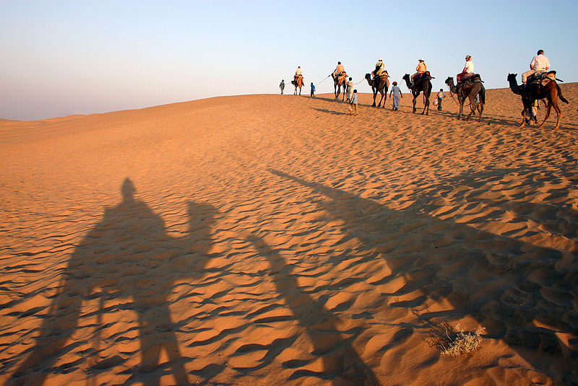

Slide 5
The position of Thar desert (orange colour)

Slide 6
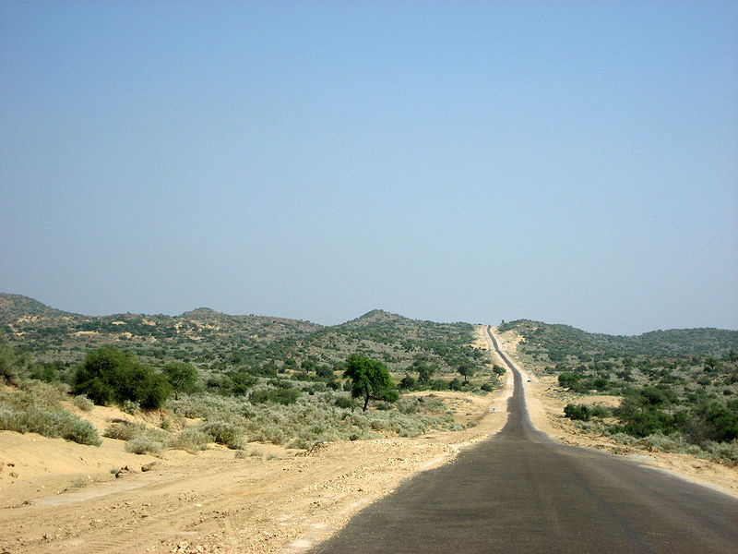
Due to severe weather conditions, there are few highways in the Thar desert. Shown here is a road in Tharparkar District of Sindh, Pakistan.

Slide 7
The Coastal plains:
One the basis of the locatin and active geomorphological process – divided into two
The western coastal plain and
The eastern coastal plains
It is believed the city of Dwarka part of the Indian main land situated along the west coast is submnerged under water

Slide 8
West coast important natural ports are Kandla, Mazagaon, JLN Port of Nava Sheva, Marmagao, Mangalore, Cochin, etc.,
Extending from Gujarat coast in the north to the Kerals coast in the south.
West coast divided into following
The Kachchh and Kathiawar coast in gujarat
Konkan in Mnaharashtra
Goan and Malabar in Karnataka and Kerala
Malabar coast has Kayals (back waters), which is used for fishing, inland navigation and tourist

Slide 9
The Eastern coast has wel developed deltas formed by rivers..
These include the deltas of the Mahanadi, the Godavari, the Krishna and the Kaveri
It has less number of ports and harbours
The continetnal shelf extends up to 500 km into the sea
This makes it difficult for the development of good ports and harbours

Slide 12
The islands:
Ther are two major island groups
One in the Bay of Bengal and
The other in the arabian Sea
Bay of Bengal island groups consist about 572 islands/islets.
The two principal groups of islets include the Ritchie’s archipelago and the Labrynth island
The entire islands divided in the two braod categories
The Andaman in the North and
The Nicobar in the south

Slide 13
The Islands of the Arabian sea include Lakshadweep and Ninicoy
The entire island group is built of coral deposits
Approximately 36 islands of which 11 are inhabited
Minicoy is the largest island with area os 453km.
The Islands of this archipelago have storm beachs consisting of unconsolidated pebbles, shingles, cobbles and boulders on the eastern seaboard.

Slide 14
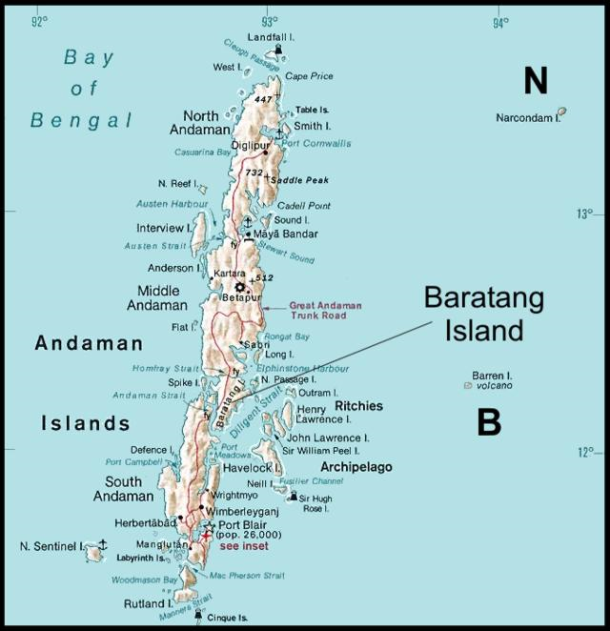

Slide 15
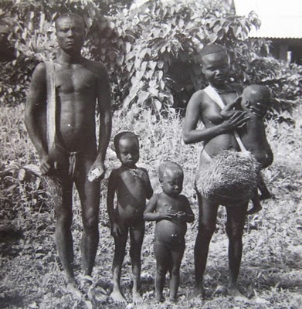
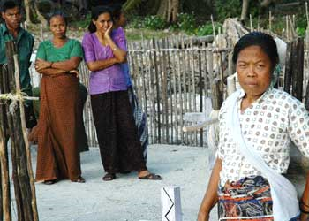

Slide 16
